Slide 1
Financial Liability Investigations of Property Loss (FLIPL) Training

Slide 2
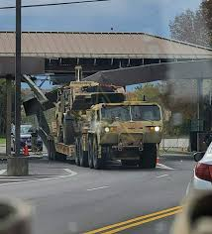
Agenda
What is a FLIPL?
Why do we do them?
When do we do them?
How do we do them?
What are the alternatives?

Slide 3
What is a FLIPL?
Financial Liability Investigation of Property Loss.
“An instrument for recording circumstances concerning loss, damage, destruction or theft (LDDT) of Army property. It serves as, or supports, a voucher to adjust property records on which the property is listed. It also serves to determine any question of responsibility (financial or otherwise) for absence or condition of the articles.” AR 735-5, Definitions.
AR 735-5 uses the term “FLIPL” to refer to both the investigation and the administrative packet that accounts for the property loss. AR 735-5, 2-1.
Put simply, a FLIPL is both an investigation and an administrative tool to account for lost or damaged property.

Slide 4
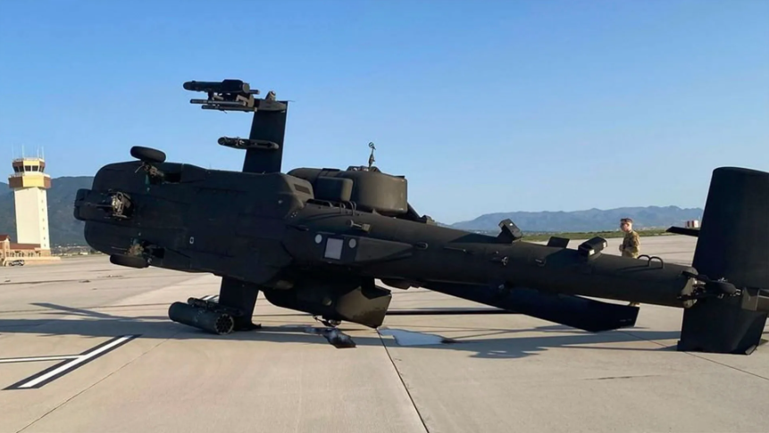
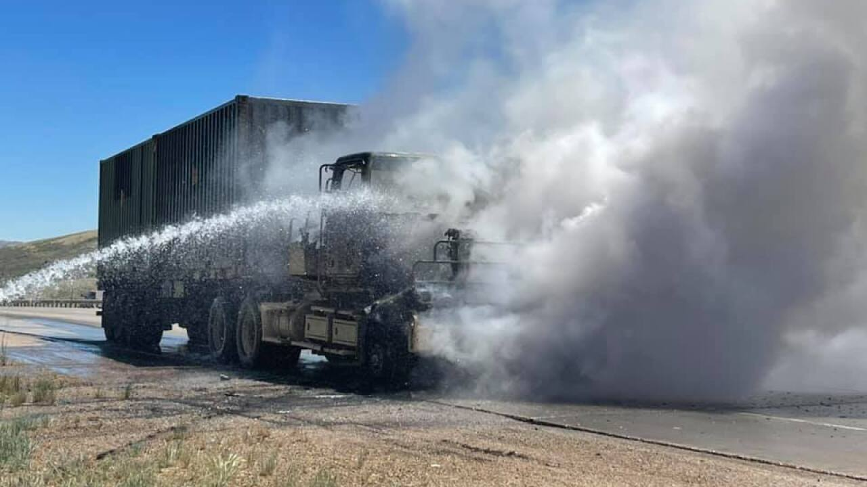
Why do we do FLIPLs?
Documents the circumstances concerning the loss or damage of Government property.
Serves as an administrative tool for adjusting property records.
Documents a charge of/or provides relief from financial liability for an individual or entity.

Slide 5
When do we do FLIPLs?
A FLIPL is one of several methods available to relieve an individual or organization from responsibility for property. AR 735-5, 5-2.
AR 735-5, 5-3 lists circumstances when FLIPLs are mandatory, they include (but are not limited to):
Negligence/willful misconduct suspected; individual does not admit liability.
Loss involves a change of the APO’s (think PBO) inventory and out-going APO does not voluntarily reimburse.
Value of loss exceeds the responsible individual’s monthly pay.
Special circumstances – (e.g. loss of public funds, fire/theft/natural disaster, certain combat losses, bulk fuel, etc.)
When investigation is necessary to determine cause/responsibility for the loss. (See AR 735-5, 5-3(a)(10)).
Certain losses require a FLIPL and an AR 15-6 investigation:
Loss of controlled inventory items.
Sensitive item serial number changes of more than two characters.

Slide 6
How do we do FLIPLs? – Process Overview
Step 1: Initiation
Step 2: Investigation and Recommendation
Step 3: Adjudication
Step 4: Notification
Step 5: Collection
Starts when loss is discovered.
Individual notifies supervisor/command.
Organization conducts preliminary search.
Organization identifies loss/gathers initial information.
Organization initiates eFLIPL.
eFLIPL initiated, document number assigned.
FLO appointed.
FLO investigates makes recommendation.
Initial notification of liability.
Rebuttal.
Appointing authority review.
Appointing authority decision sent to approving authority.
Approving authority receives packet.
Legal review.
Review by approving authority.
Decision by approving authority.
Approving authority notifies individual.
Individual can request reconsideration/appeal.
Reconsideration/appeal adjudicated.
FLIPL provided to finance and accounting office for collection.

Slide 7
FLIPL Authorities
Appointing authority:
O-5 (or O-4 in O-5 billet), GS-13 (or GS-12 in GS-13 billet)
Loss >$250,000 or controlled item: first O-6
Approving authority:
Normally: O-6 or above, GS-15
Loss <$5,000: Can be delegated to O-5, GS-14
Loss >$250,000 or controlled item: first GO/SES, GS-15
Appeal authority:
Next in chain of command above approving authority

Slide 8
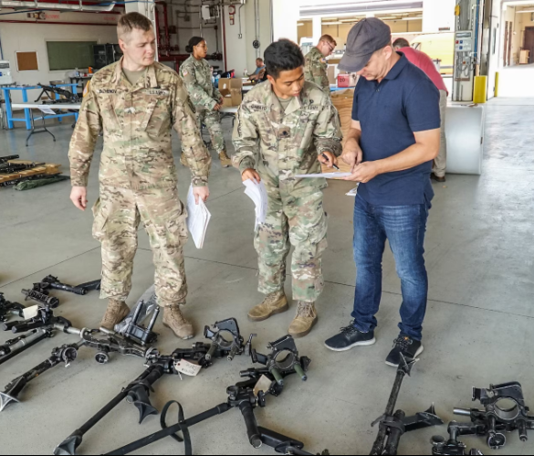
FLIPL Process Basics – Step 1 (Initiation)
FLIPL process begins when the loss is discovered.
Soldier who discovered loss should notify supervisor immediately.
Organization should conduct a preliminary search to locate missing items.
Organization gathers initial facts (identifies lost/damaged items, basic dates/circumstances).
Organization initiates FLIPL process by creating DD Form 200. Must use eFLIPL application.

Slide 9
FLIPL Process Basics – Step 2 (Investigation)
Begins when DD200 is initiated in eFLIPL application and document number is assigned.
DD200 is forwarded to appointing authority.
Appointing authority conducts initial review and determines:
If an investigation is required by higher authority/regulation.
If sufficient information exists to provide a clear understanding of the circumstances surrounding the loss or damage of GP and to determine the proximate cause.
If an investigation is work the expenditure of time/effort.
If investigation is required, appointing authority appoints/advises FLO.
If investigation is not required, appointing/approving authorities have options for assessing/relieving of liability without full investigation.

Slide 10
Step 2 – FLO Requirements
Must be:
E-7/GS-7 or above.
Senior to any individual subject to potential liability.
FLO is responsible for:
investigating the loss;
determining the cause/value of the loss;
determining if assessment of financial liability is warranted;
determining the amount of financial liability that should be assessed and upon whom;
completing findings and recommendations establishing the above;
notifying those found liable and reviewing rebuttal matters;
providing finalized recommendations to the appointing authority.

Slide 11
FLIPL Investigation - Basics
Individuals may be held financially liable for loss/damage if they were negligent/committed willful misconduct and their negligence/willful misconduct was the proximate cause of that loss/damage. AR 735-5, 6-7.
To make this determination, the FLO must understand the concepts of: (1) responsibility; (2) culpability; (3) proximate cause; (4) loss.
“Preponderance of the evidence” standard (“more likely than not”).
Loss
Responsibility
Proximate Cause
Culpability

Slide 12
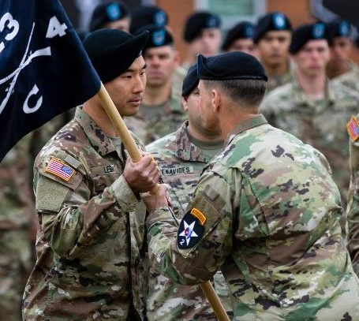
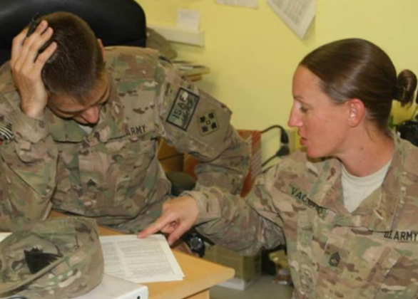
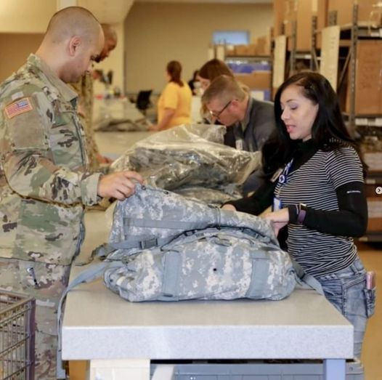
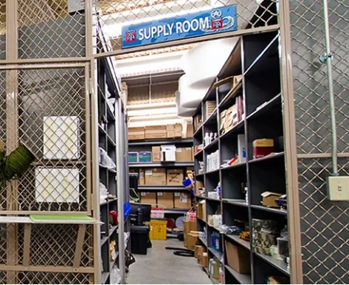
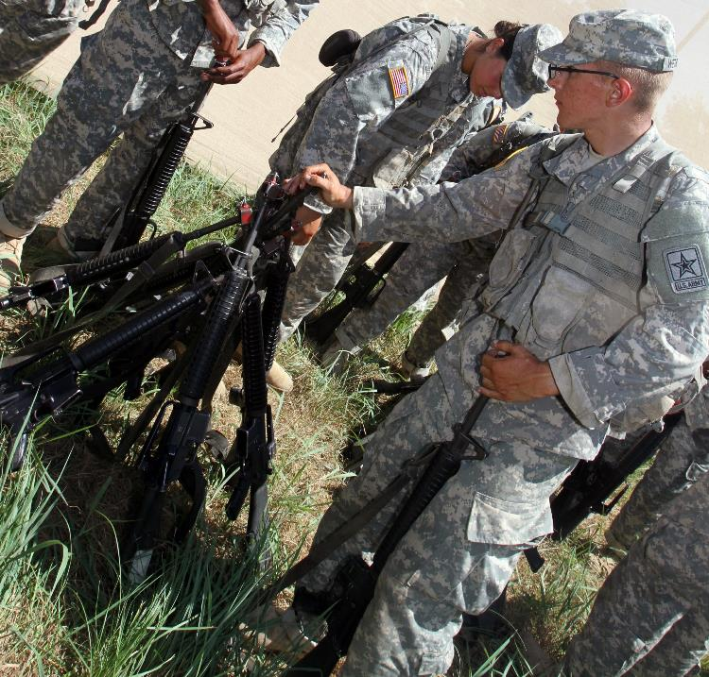
FLIPL Investigation - Responsibility
Command
Obligation of an individual to ensure Government property is properly used/cared for.
Five types
Command responsibility – commander’s inherent, position-based responsibility
Supervisory responsibility – supervisor’s inherent, position-based responsibility; not dependent on signed hand receipts
Direct responsibility – individual’s responsibility to property for which they are formally receipted
Custodial responsibility – position-based responsibility for property in storage, awaiting issue, etc.
Personal responsibility – responsibility based-upon physical possession, with or without receipt
Supervisory
Direct
Custodial
Personal

Slide 13
FLIPL Investigation - Culpability
A determination of fault. Based upon violation, through negligence or willful misconduct, of a particular duty of care toward the property.
Negligence standards:
Simple negligence – failure to act as a reasonably prudent person would under similar circumstances
Gross negligence – extreme departure from actions expected of a reasonable person; reckless, deliberate, or wanton disregard for foreseeable consequences.
Willful misconduct – intentional wrongful/unlawful act or omission; includes misappropriation.
* Culpability should be judged on a case-by-case basis, consider reasonablness of a person’s conduct based upon: circumstances, age, experience, physical condition, special qualifications, type of responsibility, type/nature of the property, nature/complexity/level of danger/urgency of ongoing action at time of loss, adequacy of supervisory/property control measures.

Slide 14
FLIPL Investigation – Proximate Cause
Negligence alone not enough; must also be proximate cause of the loss.
Cause which, in a natural and continuous sequence of events unbroken by a new cause, produced the loss or damage.
Could have more than one proximate cause.
Could have intervening facts that sever proximate cause.
Ex. Speeding Soldier hits rear of vehicle in front of him. Tow truck driver later hooks front of damaged vehicle improperly and causes more damage. Soldier was negligent and proximate cause of rear damage, but not front damage.

Slide 15
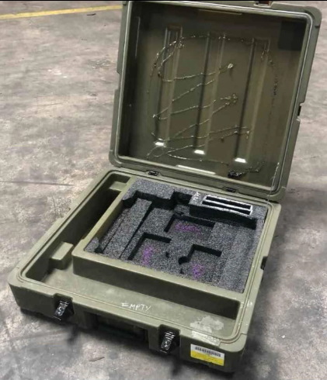
FLIPL Investigation – Loss
Loss of, damage to, or destruction of Government property. Includes physical loss and loss of accountability. Property is considered “lost” when it cannot be accounted for by the person responsible for it.
FLO is responsible for determining the amount of the loss and the amount that should be charged.
Amount should represent the “actual loss,” (ie. the difference between the value of the property immediately before loss and after); not replacement cost.
Requires consideration of such things as cost of repair, fair market value, salvage credit, depreciation, etc. Refer to AR 735-5, Appendix B.

Slide 16
FLIPL Investigation – Loss (Continued)
Financial liability for property loss is generally capped at the amount of the loss or one month’s base pay, whichever is less.
Full amount of the loss may be assessed for:
Loss of property by an accountable property officer (think “PBO”)
Loss of personal arms and equipment by Servicemembers
Equipment assigned for individual use/care; weapons, OCIE, etc. (“Do you turn it in at the end of the day?”)
Losses by states/territories of the U.S., contractors/contractor employees, NAF activities
Losses of public funds
Losses involving government-housing where gross negligence/willful misconduct found
Where multiple individuals are found liable for loss, they must be held collectively liable. See AR 735-5, 7-4(2), Table 7-3.

Slide 17
FLIPL Investigation – Summary
FLO’s findings and recommendations must establish the following:
Findings
Findings should be supported by evidence and reference relevant exhibits included in the investigation.
Should include findings necessary to establish the four elements of financial liability:
Responsibility – “Specialist Tom Doe had personal responsibility for the vehicle as its driver based upon the dispatch log included as Exhibit A.”
Culpability – “Specialist Tom Doe was driving the vehicle above the posted speed limit based on the military police report included as Exhibit B.”
Proximate cause – “Specialist Tom Doe’s speeding ultimately caused the vehicle rollover and the associated damage.”
Loss – “The amount of actual loss to the Army is $X.XX, which is based upon the cost of repair established by Exhibit D.”
Recommendations
Must be logical recommendations based upon the established findings.
Must make a recommendation regarding whether individuals be held financial liable and, if so, at what amount
“Recommend all persons be relieved of responsibility and accountability for the lost property;” or
“Recommend [individual’s name, grade, and EDIPI] be held financially liable in the amount of [dollar amount].”

Slide 18
Step 2 – Post-Investigation
If liability is not recommended, FLO sends completed FLIPL to appropriate authority.
If liability is recommended:
Initial Notification – FLO notifies respondent of recommended liability and their rights.
FLO uses notification memorandum, which must include content listed in AR 735-5, 11-3(c).
FLO provides complete copy of the FLIPL with exhibits.
Respondent signs DD Form 200 acknowledging receipt of notice.
Rebuttal
Respondent has 7 calendar days to submit rebuttal statement. (15 if different installation/30 if different country).
FLO Finalization – FLO considers new evidence/allegation of error; updates DD 200 if needed; forwards to appointing authority.
Appointing authority reviews and either directs corrections or forwards to approving authority.

Slide 19
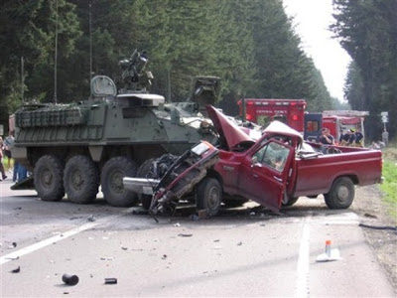
FLIPL Process Basics – Step 3
Approving authority receives DD 200 and conducts an initial review.
If liability is recommended, approving authority obtains legal review:
Legal advisor must provide written opinion on legal sufficiency; provide recommendations if not sufficient.
Approving authority cannot assess liability if findings and recommendations are found to be legally insufficient.
Approving authority finalizes FLIPL approving of or relieving from liability.

Slide 20
FLIPL Process Basics – Step 4
Approving authority notifies individuals concerned if liability has been approved.
Request for Reconsideration/Appeal:
Respondent can request reconsideration by approving authority; submit new evidence.
If requested approving authority considers any new evidence for legal error; can reverse or continue assessment of liability.
If approving authority decides to continue liability, FLIPL must be forwarded to the appeal authority for final determination.
Approval authority notifies individual of appeal authority’s decision; notifies of post approval rights.

Slide 21
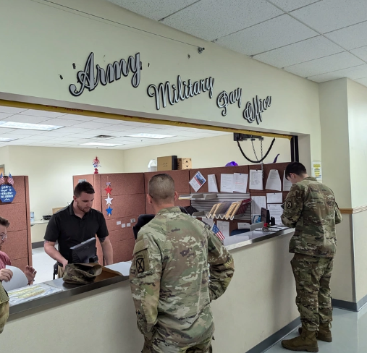
FLIPL Process Basics – Step 5
Approving authority sends copy of the FLIPL to the finance and accounting office (FAO) to process debt.
Civilian personnel only can request a hearing with through the FAO.
Enlisted personnel can request remission of cancellation of indebtedness through their commander IAW AR 600-4.
Soldier can request extension of collection period based on hardship through the approving authority to the FAO.
Submit a DD Form 149 application to the Army Board of Correction for Military Records (ABCMR).

Slide 22
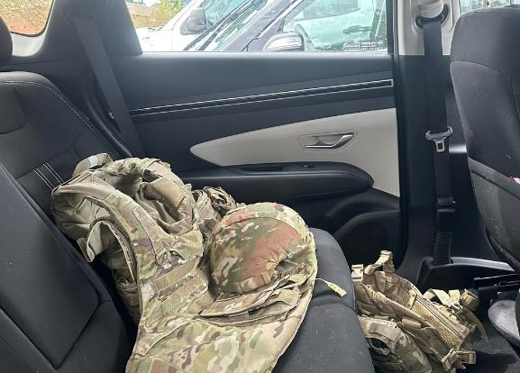
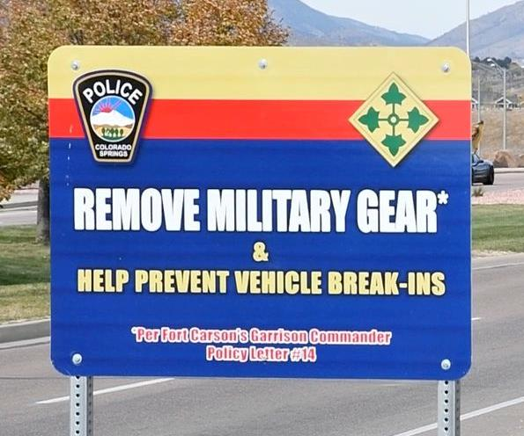
FLIPL Alternatives
Statement of Charges
Available when: (1) respondent admits liability and agrees to pay; (2) charge does not exceed one-month’s pay; and (3) mandatory FLIPL or 15-6 not otherwise required.
“Short FLIPL”
Available when approving authority determines sufficient information is initially available to determine liability without investigation.
Respondent retains notification/rebuttal rights.
See AR 735-5, 4-3 for other administrative alternatives (e.g. loss due to abandonment order, contamination, unserviceable equipment).

Slide 23
Questions?

